Slide 1
The Pacific Northwest:
Wild Versus Farm Raised Salmon
Chapter 17
Jonathan Caal, Alique Cherchian, Carmina Diaz,
Matthew Lindsay, Michelle Hernandez, & Johnjimy Som

Slide 2
Historical Geography
Native Americans
Humans migrated to the region about ten thousand years ago, about 3 thousand years after the glacial retreat. The people lived in fishing villages and depended on the abundant natural resources the land provided like coniferous timber (needle shaped or scale-like leaves), shellfish and salmon.
Native Americans tribes like the Algonquianin northern California; Chinook in Oregon and Washington; and Haida, Tlingit, Tsimshian in British Columbia.
European discovery in the Mid-eighteenth century devastated indigenous population because of smallpox and other European diseases. But despite the outbreak in diseases the remaining natives still practice cultural traditions like salmon based lifestyle, potlatch, and totem poles.
Notes:
About 10 thousand years ago once after the glacial retreat humans migrated to the Pacific NorthWest and was abundant with natural resources. Like different trees, shelfish and Salmon
The different Native American tribes that settled here were the Algonquianin in Northern California, Chinook in Oregon,Tlingit in Washington and Haida and in British Columbia
European discovery came with Devistation to the indigenous population like smallpox and other diseases.
But cultural allowed the continuation of the Tribles bycultual practies practices like Salmon based life style, potlatch, and Totem Poles

Slide 3
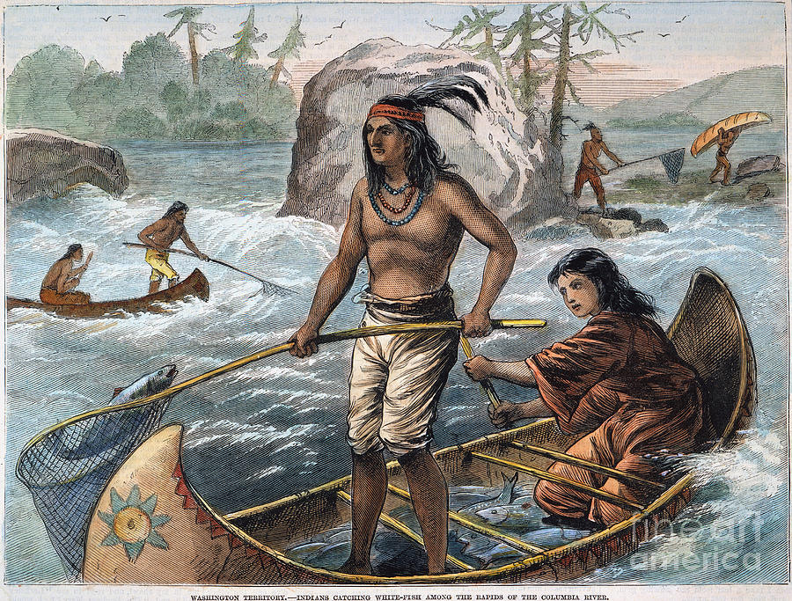
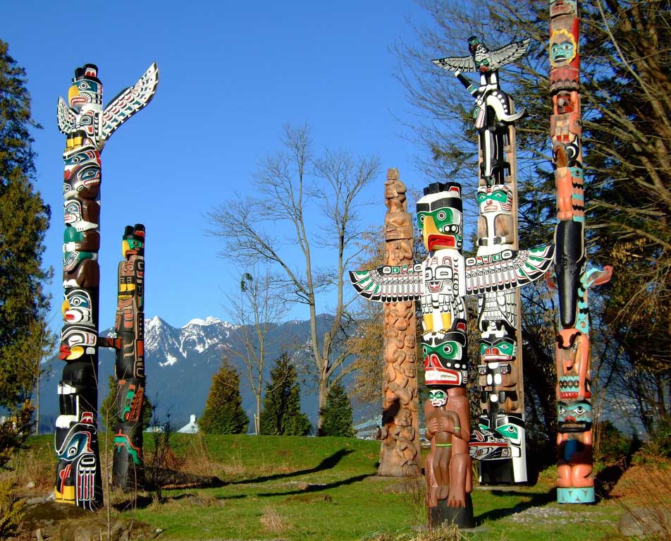
Native Americans Cont..
The long-term existence of these local groups depend on communal land and sustainable fishery.
A couple of things have affected the fishery including, overfishing and for-profit fishing from natives, warming waters, El Nino, dams and sea lions.
Notes:
Local groups depened on Communal Land and sustainable Fishery
Things that affected fisher include for-profit fishing, Warming waters, El Nino, Dams, and sealions

Slide 4
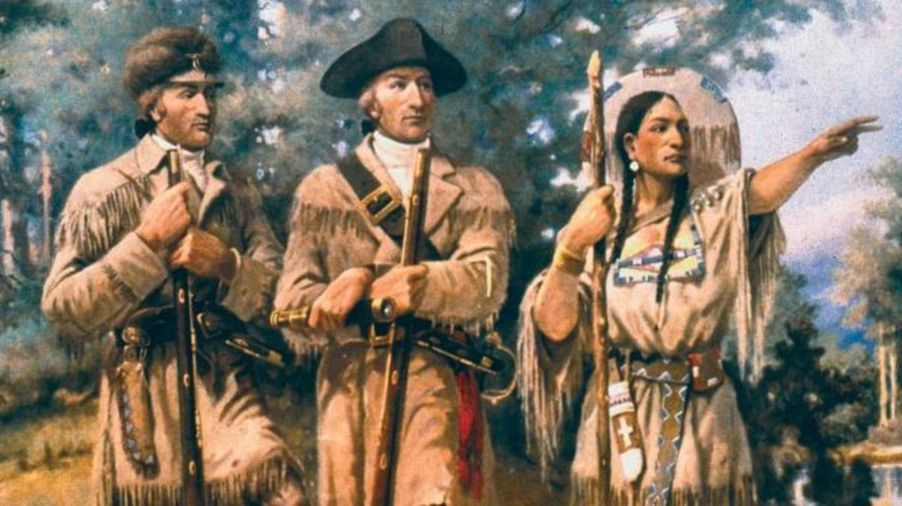
Hudson’s bay and fort Vancouver
Lewis and Clark were the first white men to search out for a transcontinental water route.
John Jacob Astor was influenced by Lewis and Clark’s published works to extend fur trapping into the territory
Astor’s trading company established western trading post for Fort Astor
Notes:
Lewis and clark were the first white men to search for Transcontinental water route
Their Written works influenced fur trader anf hunter John Jacob Astor
Aster’s trading company established Fort Astor as a Western Trading post

Slide 5
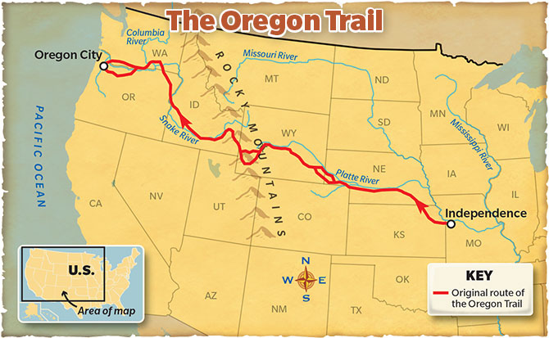
Once the Oregon trail was established the trading post began to increase in productivity
The Oregon trail symbolized the credo of Manifest destiny and the expanding power over the British
The British Hudson’s bay created the competition of the Vancouver and Washington forts. They competed for land at the mouth of the Columbian River
In 1846 the Oregon treaty extended the 49th parallel to the pacific coast and established a border between United States and the British.

Slide 6
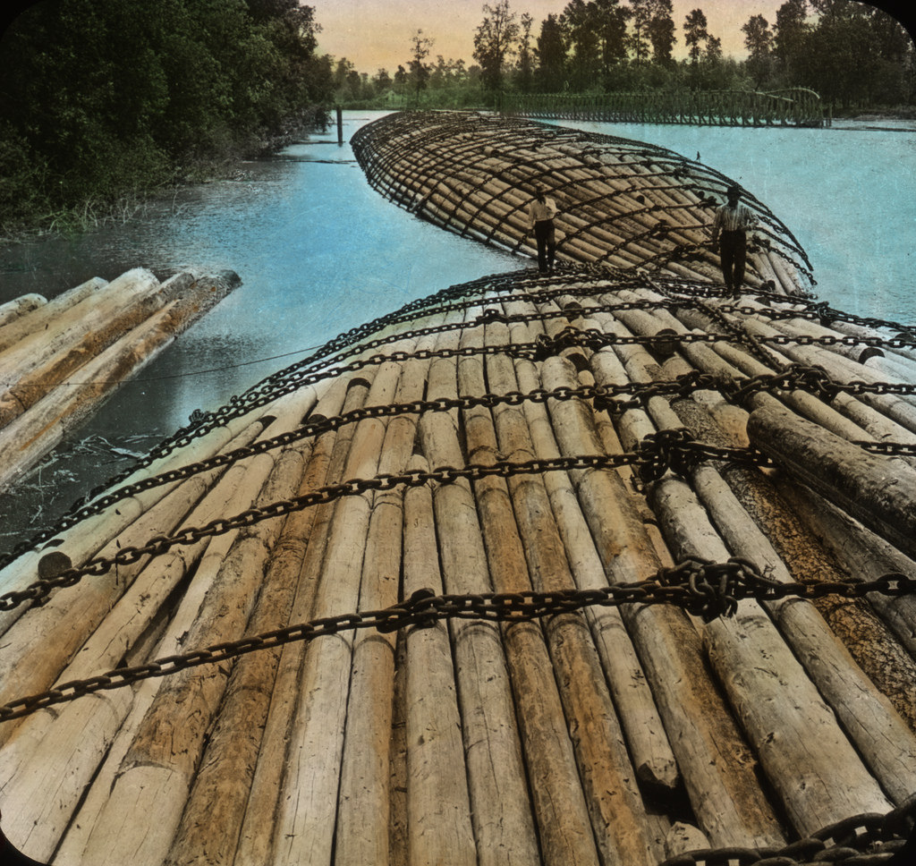
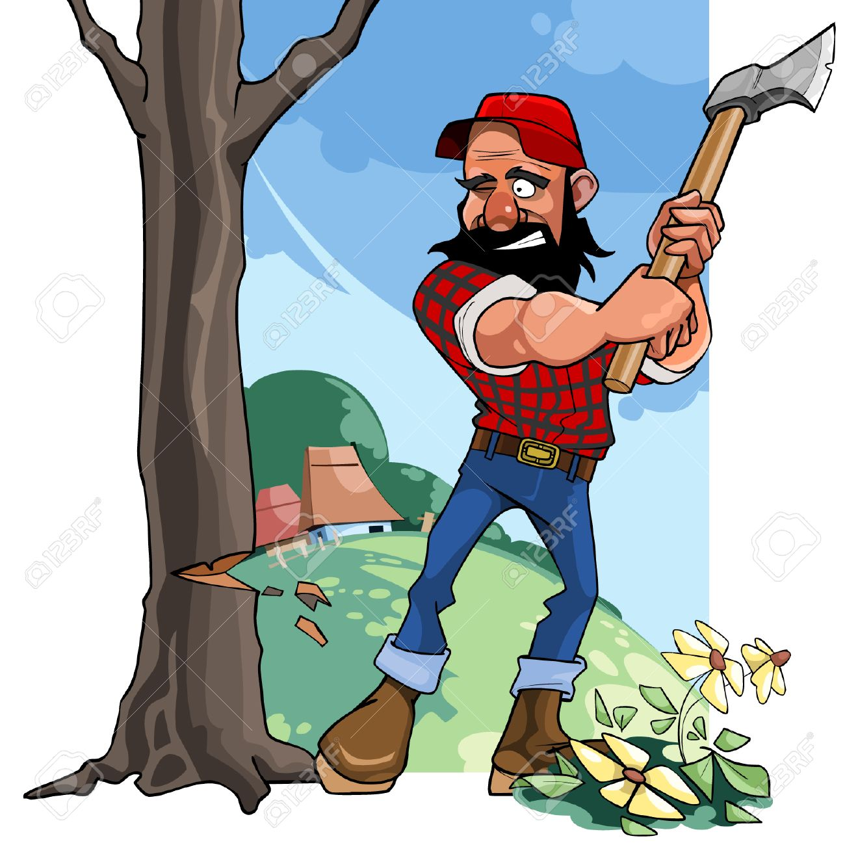
Settlement
After the Gold rush when California outgrew its own resources businesses moved toward Oregon and Washington for its resources mainly its timber.
Small company towns like Port Townsend, Port Gamble and Seattle competed against each other to provide timber for the California market

Slide 7
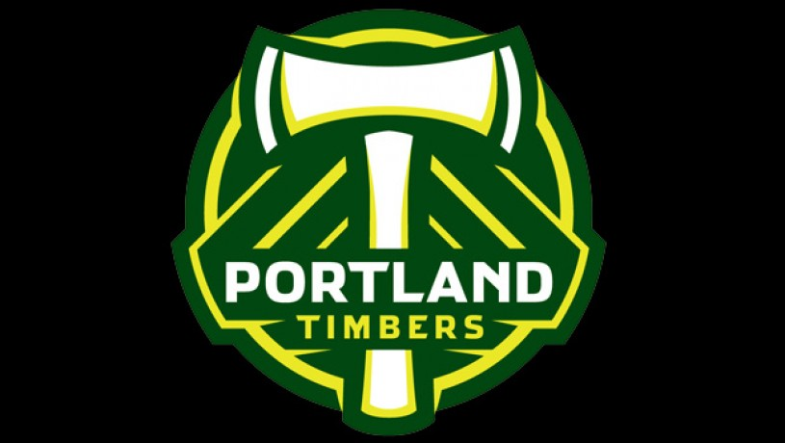
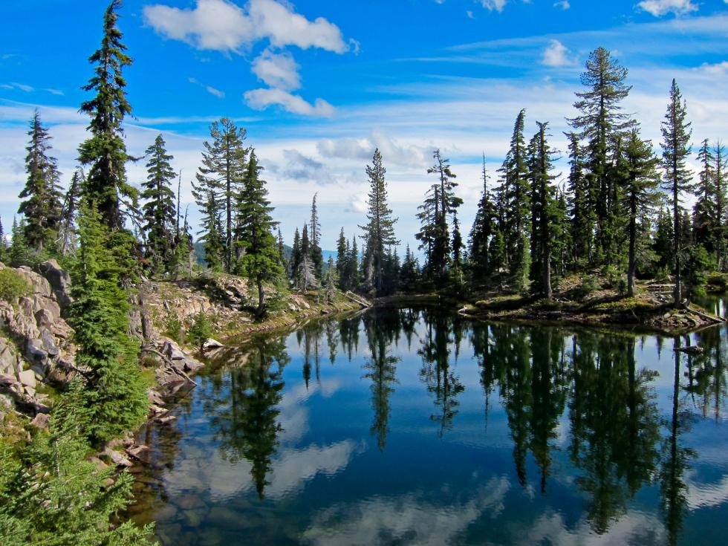
Settlement in Oregon
Portland succeeded during the California gold rush by providing crops from along the Willamette and Columbia River
Steamboat transportation along those rivers established a market-based lumber and agricultural company
Portland went from a handful of houses in in 1850 to a population 2,874 in 1860
Rail access in 1883 settled Portland’s position as the regional trade center
Notes:
Portland Succeeded during the California Gold Rush by providing crops
Steamboat Transportation along the rivers established lumber and agricultural companies
The Population of Oregon grew from 1850 to 1860 dramatically
Rail access in 1883 settled Portlands position as the regional trade center

Slide 8
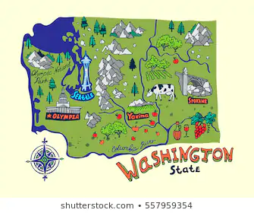
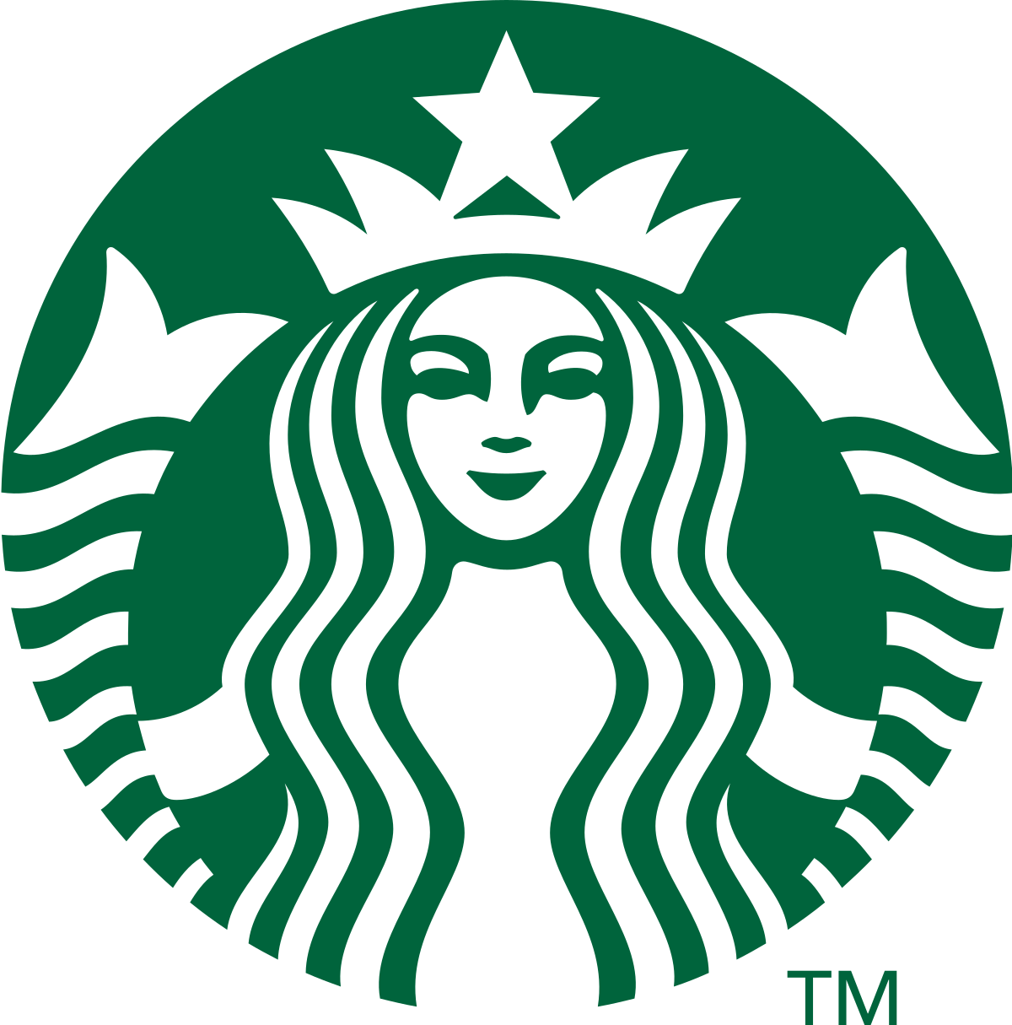
Settlement in Washington
Seattle was found in 1851
Tacoma was chosen as the most profitable region in Washington because of the Pacific Railroad in 1883
In 1897 Seattle build its own railroad that went into the interior and it became the gateway to the Klondike Gold Rush
Notes:
Seattle founded in 1851
In 1883 the Pacific Railroad was made in Tacoma because of it was the most profitable region in washington
Seattle build its own Railraod in 1897 and became the gateway to the Klondike Gold Rush

Slide 9
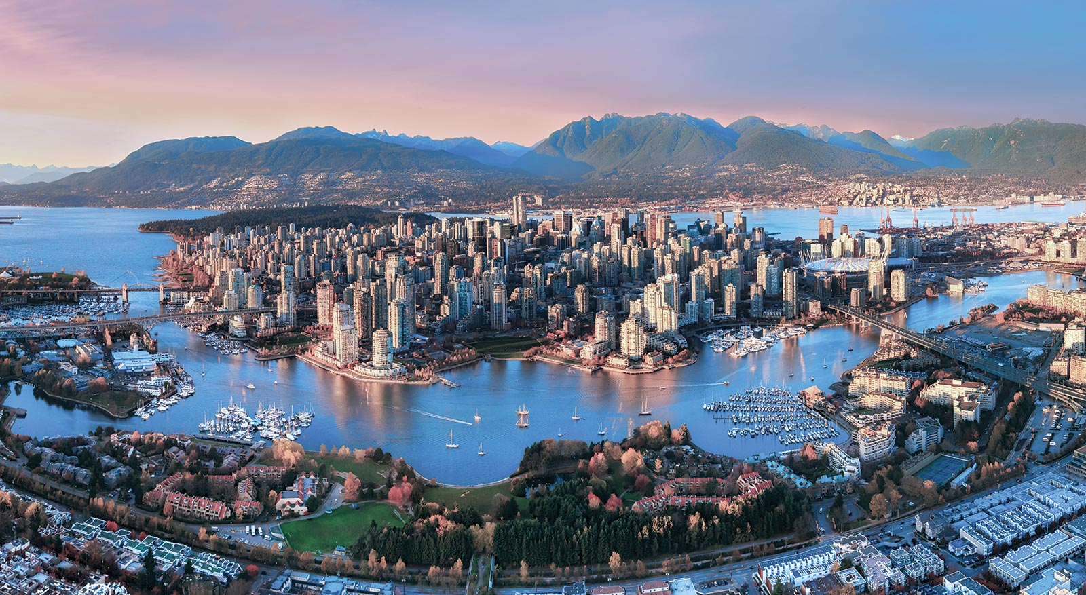
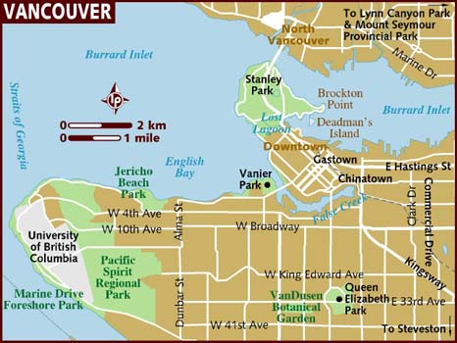
Settlement in Vancouver
Vancouver was founded as a sawmill settlement in 1886.
Because of the Klondike gold strike,
Vancouver was Canada’s gateway to the Klondike gold rush
Notes:
In 1886 vancouver was founded as a sawmill settlement.
Because of the Klondike Gold Rush Strike vancouver was Canada’s Gateway to the Klondike Gold Rush.

Slide 10

Climate
Reputation: moist & gray climate
(but this is not always pervelant)

Slide 11
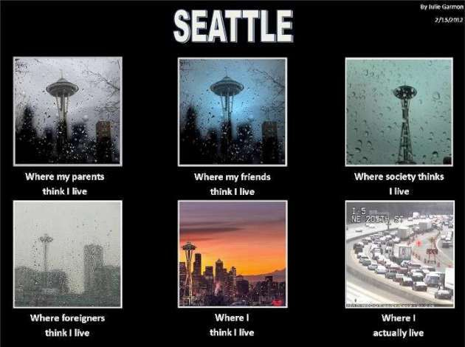
Climate
Reputation: moist & gray climate
(but this is not always pervelant)

Slide 12
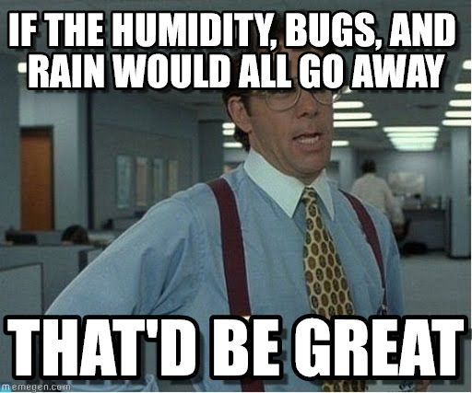
Climate: Marine Climate
“A climate strongly influenced by an oceanic environment, found on islands and the windward shores of continents…”
Small daily & yearly temperature ranges
Relatively high humidity
Lots of rain

Slide 13
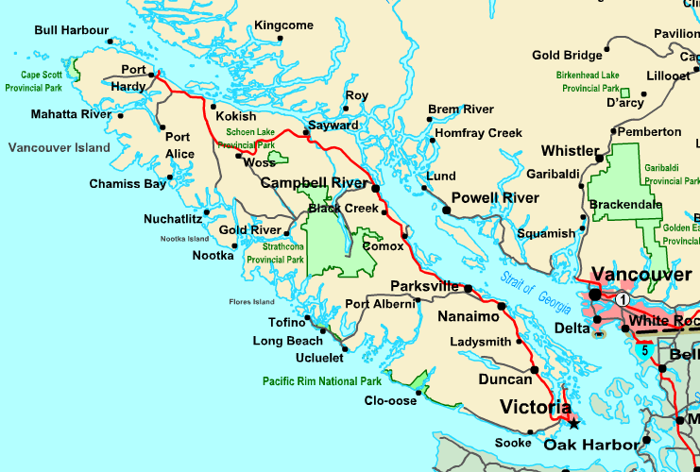
Marine Climate - Three Seasons Out of Four
Vancouver Island receives about
250 inches of rain annually
Notes:
Part of Vancouver Island Experiences 250 inches of rain annually
Island off of Canada’s Pacific Coast
To compare, Mount Olympus gets over 200 inches of rain annually

Slide 14
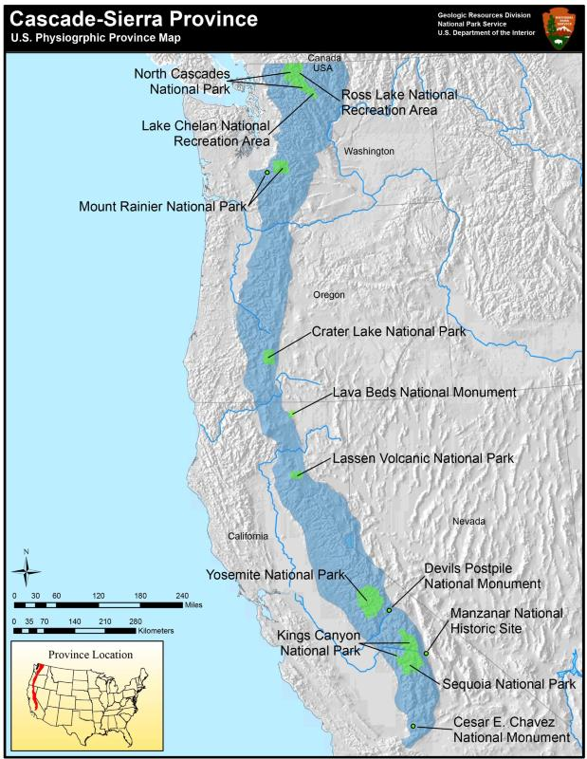
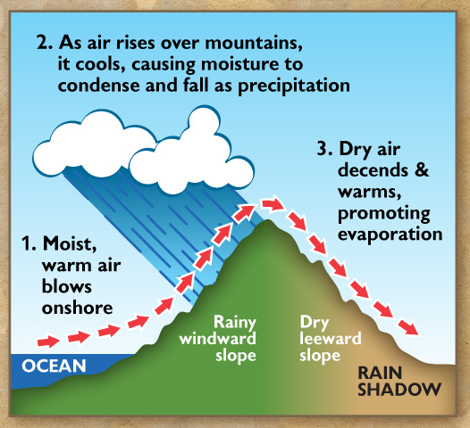
Marine Climate - Three Seasons Out of Four
The Cascades
Orographic Rainfall
Notes:
The Cascades are a mountain range from Southern British Columbia to/through Washington, Oregon through Northern California
Orographic Rainfall = westward winds cause a lot of rainfall on the west side of the mountains

Slide 15
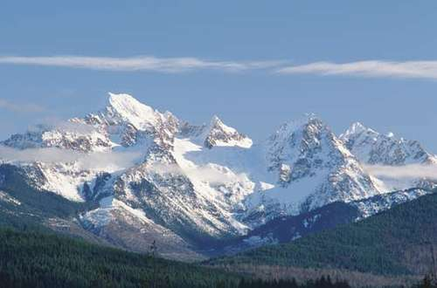
Marine Climate - The Cascades

Slide 16
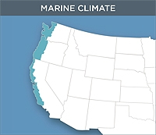
Marine Climate - Three Seasons Out of Four
Cold Ocean air decreases air pressure
Results in storms moving up the mountains
Rain or Snow depends on elevation

Slide 17
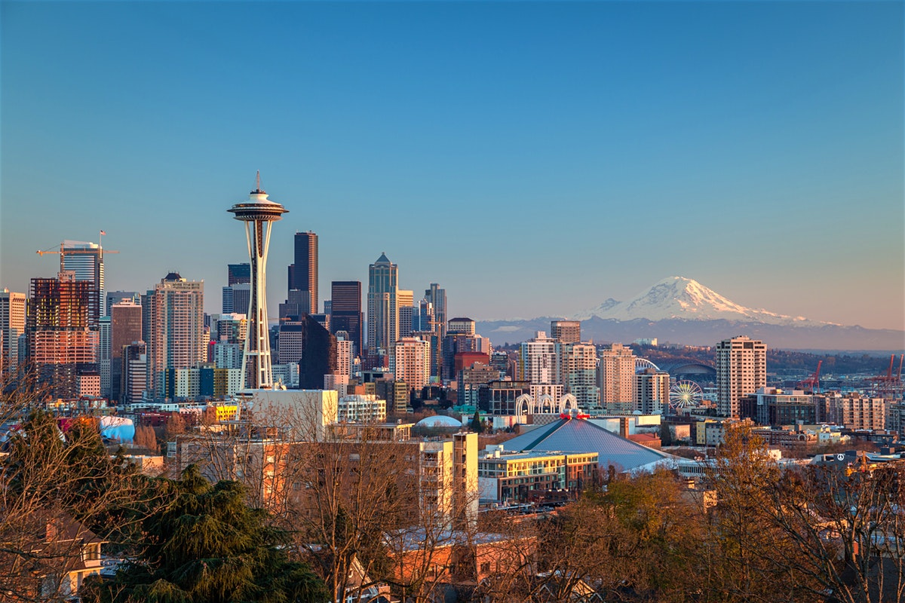
Marine Climate - Seattle
Area receives around 40 inches of rain annually
¾ during October - March
Less than 100 days/year have clear skies
Notes:
Pacific Northwest region as a whole has varied ranges of rainfall.
Some parts receive less than 10 inches, while other parts receive over 100 inches annually

Slide 18
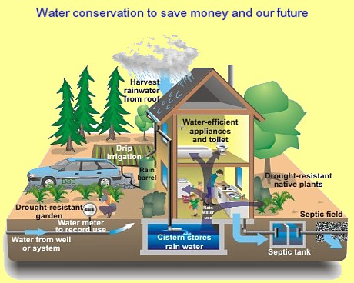
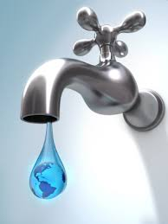
The Pacific Northwest - Climate Change
Notes:
1998-2005 drought halved the average snowpack Snowpacks provide more more than half of its water Drinking water had to be conserved

Slide 19
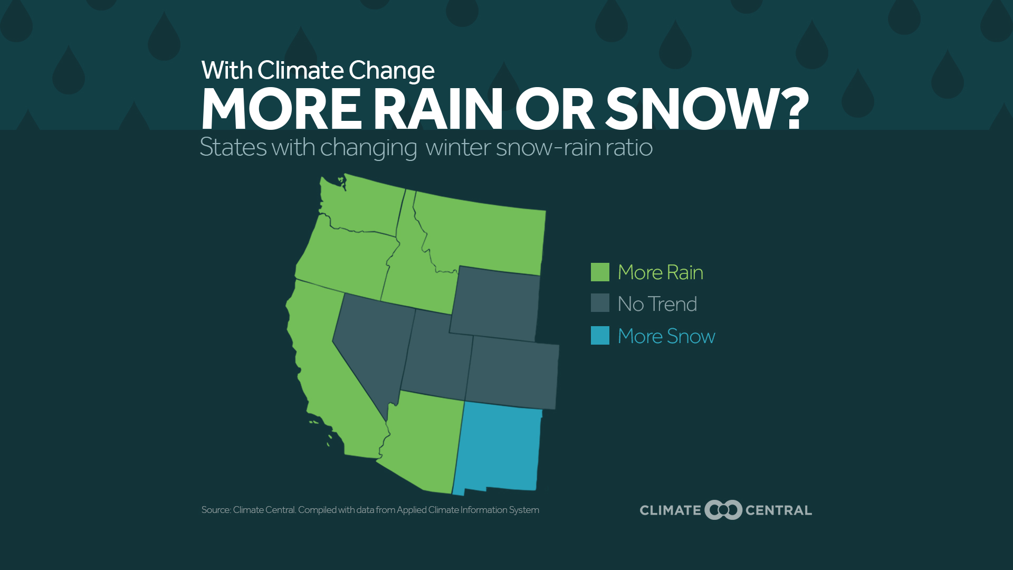
Climate Change - Future Forecasts
Higher Temperatures
1 Degree Celsius every 25 years
More precipitation
More rain than snow
Pressure for water conservation efforts

Slide 20
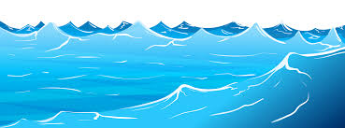
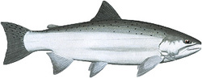
Geography
Physical:
Mountains dominating the Pacific-Northwest form a barrier separating the region from the rest of the country.
Water is abundant in the Pacific Northwest:
Three important rivers are the Columbia, Willamette in Oregon, and the Fraser river in British Columbia.

Slide 21
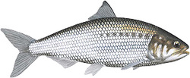
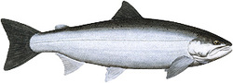
Salmon in Rivers
Columbia River
30 Dams generate hydropower in the Columbia river stimulating industrial growth and irrigating land; however,
it disturbs the salmon runs.
The harbors are dredged ( cleaned out ) regularly to let large ships through which has contributed to the loss of the salmon fishery.
Fraser River
Largest and longest river in the province.
Runs from Mount Robson to Vancouver
Major salmon producer
Contains 5 types of salmon
There are Environmental pressures that threaten the salmon such as urbanization and agricultural development.
Salmon needs cold water to survive.
The cold oxygenated water of the Pacific Northwest has been an ideal habitat.
American Shad
Sockeye Salmon

Slide 22
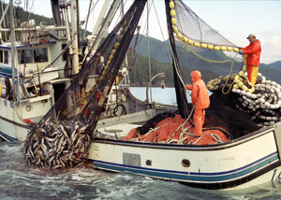
The Economics of Wild-Caught Salmon
A Traditional Occupation for the Region
Highly regarded for taste, wild-caught salmon, particularly in Alaska, only makes up about 14% of supply.
Salmon industries face fierce competition from farm-raised aquaculture that can produce Salmon year-round.
Increased human activity and development of the coastline largely contributes to salmon depletion.
Rivers and streams have mostly been dammed, disrupting natural salmon spawning patterns.
Notes:
Fresh, wild-caught salmon is generally considered a delicacy, however it is expensive and costly to produce and distribute.
Salmon aquaculture dominates the market
Development along the Pacific Coast has increasingly put strain on wild salmon stocks, who find it difficult to naturally spawn and make their way up rivers and streams that have been dammed - in an attempt to relieve this issue, local governments and environmentalist groups have sponsored “fish ladders” - using overflow from dams, they are connected water “steps” that salmon can utilize to move upriver to complete their natural spawning cycles.
Pacific salmon are disproportionately impacted when compared to Alaska or British Columbia salmon - Salmon thrive in colder water and populations off Washington are greatly affected by warmer water and coastal development - stressing salmon and lowering their numbers dramatically

Slide 23
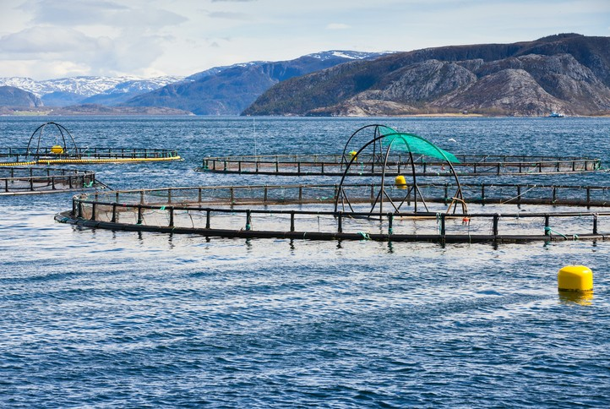
The Economics of Farm-Raised Salmon
The Aquaculture of Salmon
Defined as the farming and harvesting of salmonids for both commercial and recreation purposes.
Salmon are generally raised in large, protected nets off the coast in shallow water.
Although they are mostly protected from larger ocean predators, they are significantly impacted by microscopic organisms like sea lice.
Domestic salmonid aquaculture only accounts for 5% of consumption.
Salmon industry produces around $1 billion annually.
Notes:
The practice of breeding and raising salmon in a protected and controlled aquatic environment.
Salmon and other fish are farmed for a variety of purposes, including consumption and sport fishing - Chinook, Atlantic, Sockeye, and Pink.
However, mostly Chinook and Atlantic are farmed for their filets and flavor. Pink and Sockeye are exceptionally susceptible to disease and parasites.
Grown in large mesh framed with steel or plastic nets and cages, the salmon are usually fed a mixture of soy and cornmeal pellets mixed with antibiotics to ward off disease
Without a wild source of astaxanthin, the meat from farm-raised salmon is gray, and becomes pink because farmers add chemicals to salmon food
Astaxanthin is the substance that gives both salmon meat and flamingo feathers their distinctive pink color - present in shrimp, prawn, and krill - the primary diet of wild salmon.

Slide 24
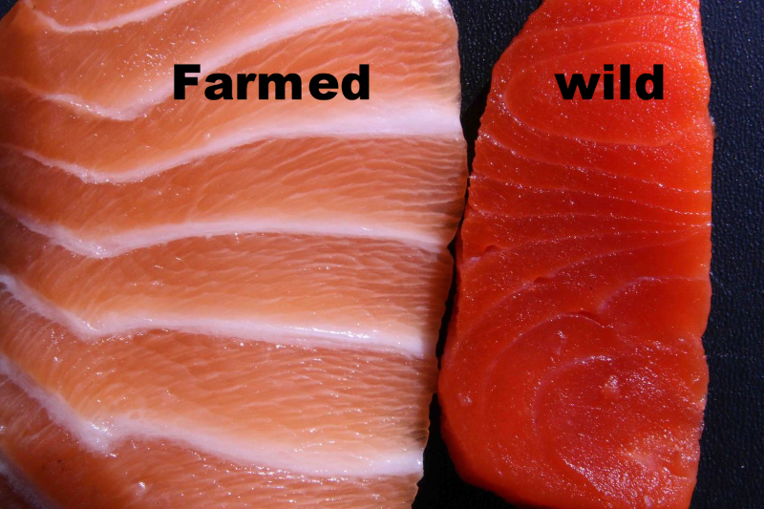
The Impact of Salmon Aquaculture
The Economics of Farm-Raised Salmon continued...
Unfortunately for fishermen, salmon aquaculture has largely replaced the fishing industry.
Major demand from consumers has put a greater demand for salmon fillets to be sold in stores.
This has resulted in a vastly different product that shows significant distinctions between wild-caught and farm-raised.
There are many possible environmental consequences to farm-raised salmon, like increased pollution.
Notes:
The traditional occupation of fisherman has mostly been replaced by farm-based aquaculture, nearly wiping out an entire industry.
Considerable consumer demand from Americans and worldwide has placed greater pressure on producers, and when combined with human intrusion and past overfishing, wild-caught salmon stocks are depleted in this region.
There are also considerable differences between the look, taste, and nutrition of farmed vs wild-caught salmon, and critics claim farm-raised salmon contains significant amounts of potentially deadly or harmful chemicals, heavy metals, and PCB’s.
Proponents argue farm-raised has higher amounts of healthy omega-3 fatty acids, so we’ll leave you to decide.
There are also environmental concerns raised by many regarding salmon aquaculture: accumulation of heavy metals at ocean floor, waste created by aggressive,
Non-native farm-raised salmon sometimes escape from their enclosures and have the potential to disrupt native populations - Atlantic Salmon are often chosen for aquaculture due to their adaptability, high price, and consistency - however, they have been known to frequently escape if farms are damaged by rough seas or storms.
Mixing of farm-raised with wild salmon can devastate wild stocks due to carried diseases or parasites transmitted to them from the farmed salmon.
Pollution can also be created from farmers attempts to mitigate parasites with the use of chemical additives
All of these pollutants have the potential to cause damage to humans and surrounding ecosystems, indeed, it can also be damaging if consumed as well.

Slide 25
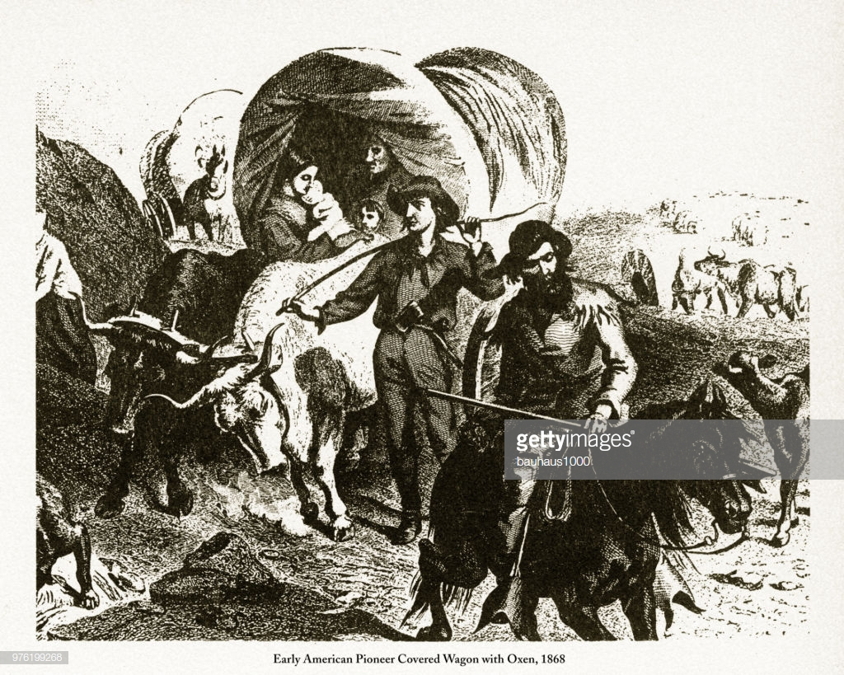
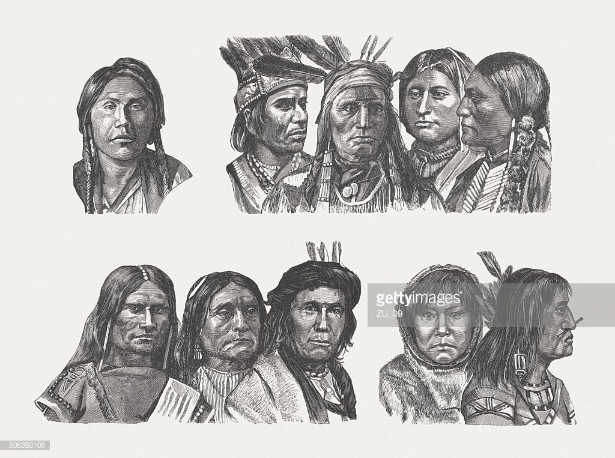
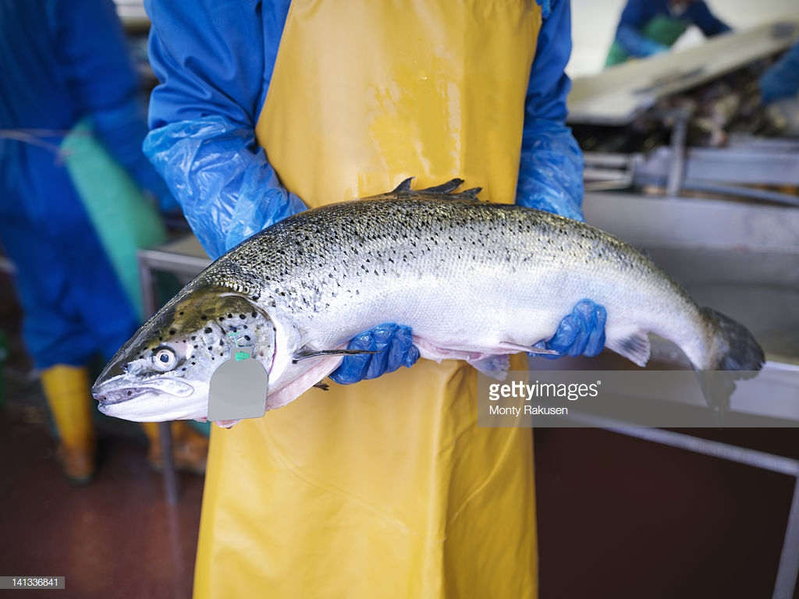
Cultural Perspectives
Two dominant issues:
Historical tension between Native Americans and European settlers
Control of salmon fishing and consumption
Notes:
So the dominating cultural issues within the Pacific Northwest region are centered on historical tension between Native American tribes and European settlers and the struggles over salmon fishing and who gets to control it.

Slide 26
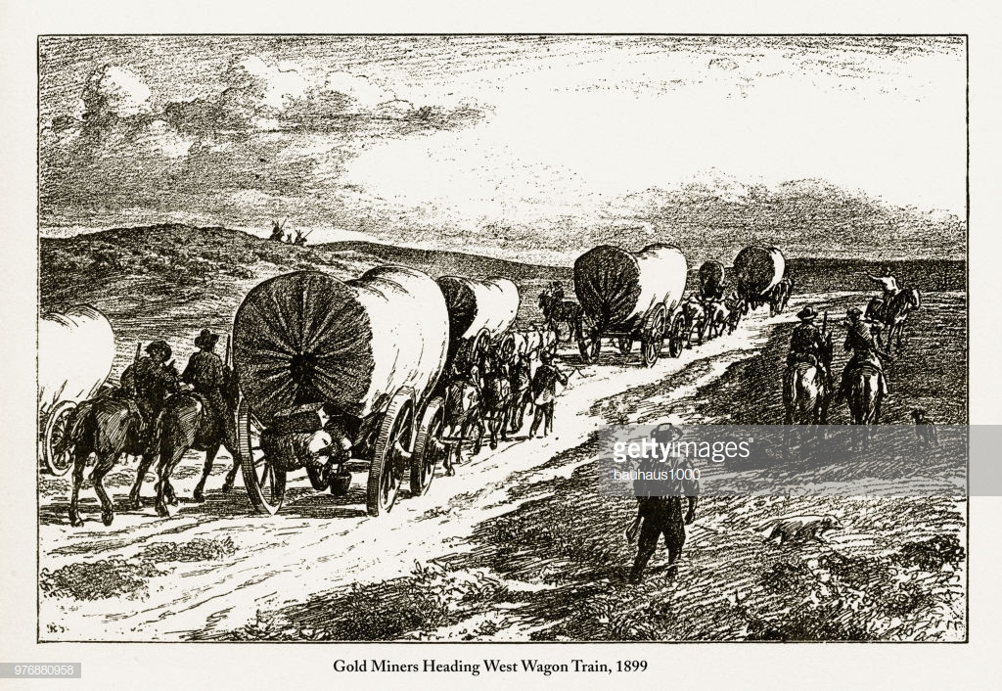

Native Americans v. European Settlers
Tension from the beginning with Lewis and Clark expedition
Early settlers set on converting Native Americans to Christianity; Native Ams. not having it
Euro settlers arrived in increasing numbers via the Oregon Trail
Native Ams. lost control of territory
Indigenous cultural values have been systematically diminished, treaties ignored
Notes:
-With the first issue, the culture clashes started way back in 1805; when Lewis and Clark tried to find an easy route to the Pacific through this region, they met with resistance from the local Blackfoot Nation
-After the Oregon Trail was established, the first settlers coming into the area had goals to convert Native Americans to Christianity; that didn’t work out so well and there was some bloodshed between the groups
-Eventually the Europeans won out, they kept coming until Native Americans lost control of their territories and their values were diminished by the new dominant culture

Slide 27
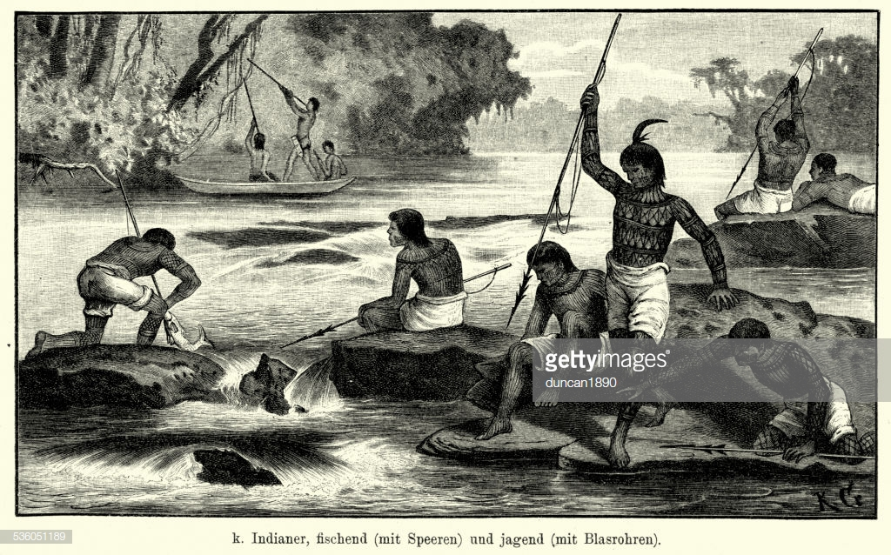
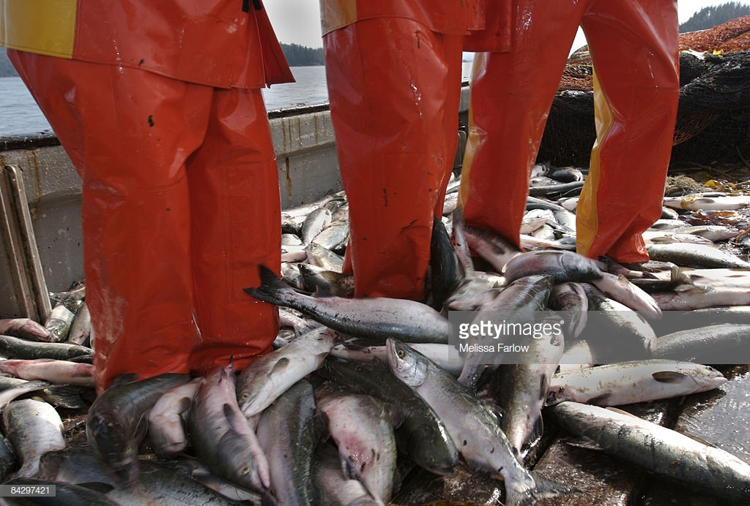
Control of Salmon
Historically Native Ams. fished sustainably
1866: Euro settlers open the first cannery; commercial salmon fishing begins
Native Americans begin to work in these canneries
1930s: Canneries die out with advent of refrigeration
1950s: Tribal fishing grounds eliminated and Native Am. fishing rights ignored
Salmon migration routes get disrupted by overfishing, habitat degradation and dams
1974: Court decision restores Northwestern tribes’ fishing rights
Currently:
Tribal groups fish for food but also for profit
Unsustainable commercial salmon “farming” dominates
Environmentalists claim Native Ams. are now overfishing
Notes:
-Now the second issue, the control of salmon fishing, also contains elements of the Native American and European tension. Before the Europeans overtook the area, the Native Americans had sustainable salmon fishing practices
-But in 1866, European settlers opened the first cannery, and the salmon fishing industry in the Pacific Northwest was born
-Native Americans went to work in the canneries until they closed down in the 1930s
-Throughout this time there were treaties that were supposed to guarantee Native Americans rights to fishing, but these treaties were ignored and in the 1950s they were officially eliminated
-In the meantime, the commericialization of fishing had a destructive effect on salmon migration routes
-However these rights were restored in 1974; but sustainable fishing practices were not restored
-So now tribal groups still fish as a way to preserve the dietary traditions of their cultures, but they’re also doing it for profit
-Salmon farms are the norm and environmentalists claim Native Americans are abusing their fishing privileges by overfishing

Slide 28
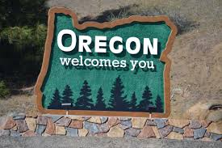
Regional Life

Slide 29
Environmental Topic & Essay Question
Wild Versus Farm Raised Salmon
What are some pros and cons about both farm raised salmon and wild salmon fishing?
Articles Food Related:
https://www.healthline.com/nutrition/wild-vs-farmed-salmon#contaminants
https://www.bonappetit.com/story/difference-between-wild-caught-and-farm-raised-salmon
Notes:
Some useful articles about the farm-raised and wild salmon fishing.
Wild salmon contains more minerals. Farmed salmon is higher in Vitamin C, saturated fat, polyunsaturated fatty acids and calories.
The production of farmed salmon has increased dramatically over the past two decades. Farmed salmon has a completely different diet and environment than wild salmon.
Farmed salmon contains much higher amounts of contaminants like PCBs (Polychlorinated biphenyl) — but the amount varies between fish from different regions.
Antibiotic use in fish farming is an environmental hazard as well as a potential health concern. Many developed countries strictly regulate antibiotic use, but it remains poorly regulated in most developing countries.
“Farm-Raised Salmon
What does that even mean? That’s a good question. In the broadest sense, it means that it was raised in some kind of aquatic farming operation, not the wild. But salmon farms vary in size, location, breeding practice, and just about everything else. Farmed salmon will differ in the same way that a carrot farmed in New Jersey differs from a carrot farmed in California.”
“Wild-Caught Salmon
What does that even mean? Well, wild salmon, as you’d probably expect, is caught in the wild. Fisherman take their boats, usually in places on the Pacific ocean like Alaska or New Zealand, and head out to catch these fish in their natural habitat. This means that when you buy wild salmon, you’re (usually) supporting smaller fishing operations in smaller towns around the world. We’re into that.”

Slide 30
Bibliography
Mayda, Chris. A Regional Geography of the United States and Canada: toward a Sustainable Future. Rowman &Amp; Littlefield Publishers, 2013
https://www.healthline.com/nutrition/wild-vs-farmed-salmon#contaminants
https://www.bonappetit.com/story/difference-between-wild-caught-and-farm-raised-salmon

